Slide 1
Facial emotion recognition using Handcrafted features and CNN
DEEP LEARNING

Slide 2
01
02
03
Introduction
Materials and Methods
Implementation
Facial Expression Regarding different Emotions.
Different Features Extraction Tools
Methodology for predicting Emotions

Slide 3
Project completed under the mentorship of Dr. Vivek Singh Verma (Associate Professor) CSE Deptt. HBTU Kanpur
Utkarsh Agarwal
3rd B.tech CSE
utkarshmittal14aug@gmail.com
Yashvardhan Singh Rathore
3rd B.tech CSE
yashsr1504@gmail.com

Slide 4
“A beloved face cannot grow ugly, because, not flesh and complexion, but expression, created love.”
—Jean Paul

Slide 5
01
Introduction
Facial Expression Regarding different Emotions.

Slide 6
Facial Emotion Recognition!
When Interacting and Associating with others emotions are expressed. Learning how to interpret them might be a difficult task, therefore technology is intended to be used as help.
Amongst the numerous facial recognition techniques or technologies which have evolved majorly and increased over time is facial emotion recognition (FER).
Emotion Recognition(ER) has a lot of real-based applications.
Like Video Games, Customers Emotion etc.

Slide 7


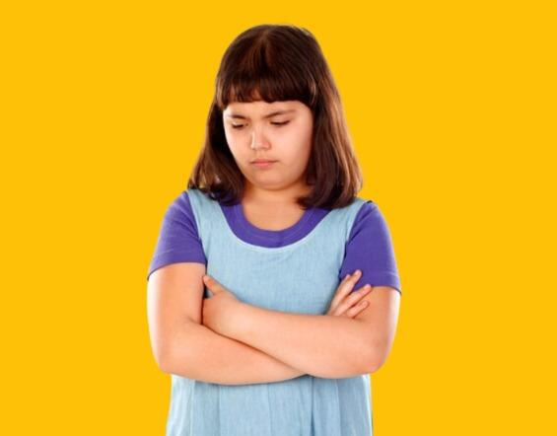
Facial expressions with features
Joy
Anger
Sad
-Raised end of mouth into a smile
-Lowered and burrowed eyebrows
-Raides chin
-Intense gaze
-Brows bent
-Lips lobe arched

Slide 8


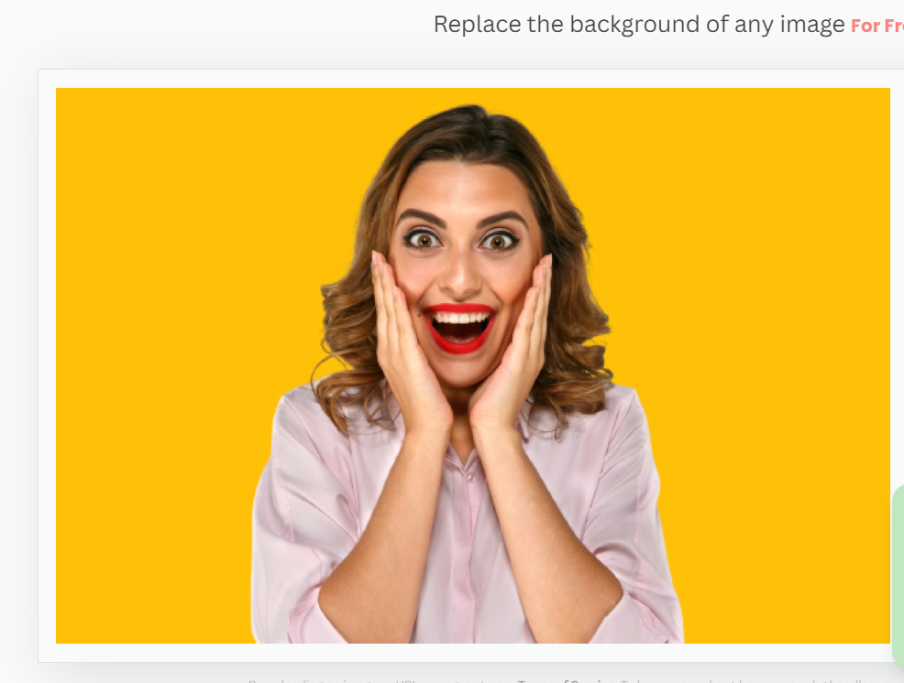
Fear
Anxiety
Surprise
-Open mouth
-wide eyes
-Closed eyes brows
- Lip smacking
-Dropped jaw
-Raised brows
-Wide eyes

Slide 9

A PICTURE IS WORTH A THOUSAND WORDS

Slide 10
02
Materials and Methods
Different Features Extraction Tools

Slide 11
Dataset Description
CK Plus
The CKplus dataset is available on Kaggle, and it contains 981 grayscale images with a resolution of 48x48 pixels.
Images are organized into emotional folders.
The dataset includes images of subjects within the age limit of 18 to 50 years, with a diversities of genders and ethnicities. Every image have been given labels from one of 7 variety of expression classes: rage, contempt, disgust, fear, happiness, sadness, and surprise.

Slide 12

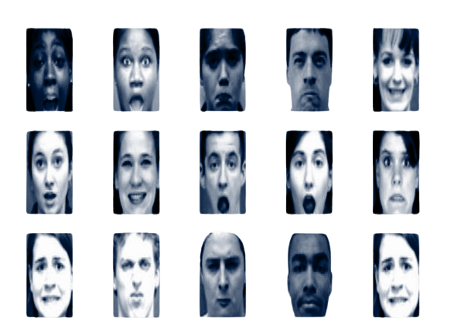
CK Plus Dataset

Slide 13
HOG Features
A feature descriptor HOG( Histogram Oriented Gradient ) is a technique that extracts characteristics from picture data.
The HOG descriptor is concerned with the structure or form of an object.
We just determine whether or not a pixel is an edge in the case of edge features.
Before applying HOG features the image must first resized and converted to grayscale.
After that the image gradient is determined, which is a combination of image’s magnitude and angle.
Then the gradient matrix is separated into cells of varying sizes to form blocks.

Slide 14
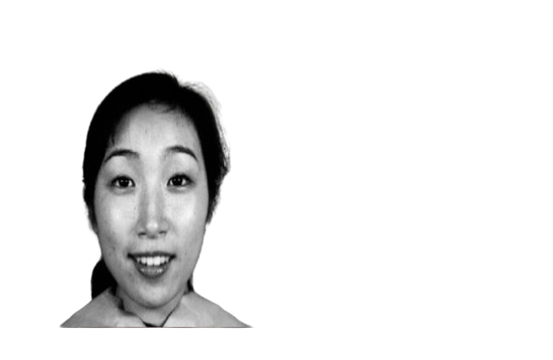
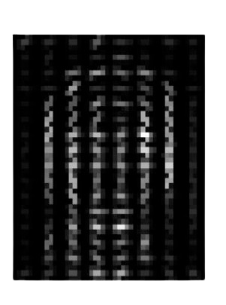
HOG Features..
Original Image
HOG

Slide 15
SIFT Features
SIFT (Scale Invariant Feature Transform) aids in the identification of the image's local features, often referred as 'key points.'
Picture matching, object detection, scene detection, and other computer vision applications can all benefit from these scale and rotation invariant key points.
We use the key points obtained by SIFT as features for the image during model training.SIFT characteristics have the advantage of being unaffected by image size or orientation.
SIFT majorly works in four parts namely construction of scale space to make certain that features are adjusted - independent, to identify the characteristics, crucial point localization is used.

Slide 16
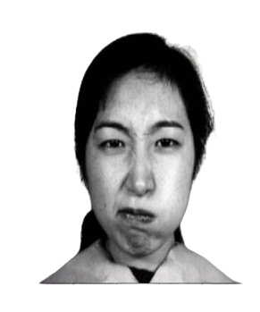
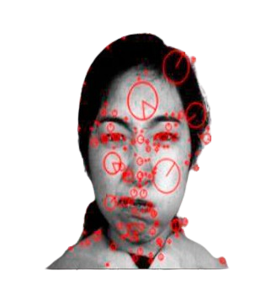
SIFT Features..
Original Image
SIFT

Slide 17
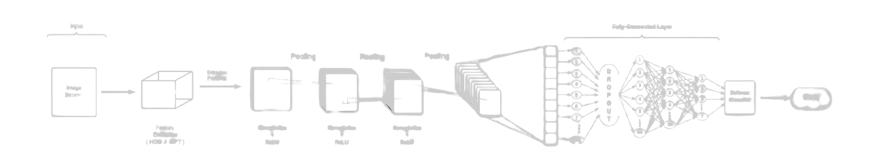
Proposed feature extraction-convolution network model
Input
Fully Connected Layer
Pooling
Pooling
Pooling
Extracting Features
DROPOUT
Image Detection
SoftMax
Output
Feature Extraction
(HOG/ SIFT)
Convolution
+
ReLu
Convolution
+
ReLu
Convolution
+
ReLu

Slide 18
Proposed feature extraction-convolution network model
In this research emotion have been analyzed using the feature extraction as the initial step and then applying or feeding those extracted features into the convolution network formed using convolutional as well as dense layers. The feature extraction is performed using HOG and SIFT.
CKplus dataset is used for the analysis purpose. The CKplus database contains 981 train images.
These images are then further disintegrated into the seven emotions in the dataset. Once the general pre-processing is complete the train image set is then passed through. The data from both the dataset is preprocessed and then individually feature extraction techniques are applied to bring the key features or the important features.
These features involve essential information which main regards to the emotion detection process. Key-features extracted included information about the jawline structure, eyes are winked or mouth open etc.
Mentioned parameters serve an important role in better analysis of emotions.
The retrieved or detected features are then fed into a convolutional and dense layer neural network. Three consecutive convolutional layers are built into a sequential model, the output through which is then flattened.
The flattened output serves as an input to the dense layers that are fully connected and have relu activations. The dense layers added into the sequential model have 128,64,16 and 7 neurons respectively.
The output dense layer is structured having 7 neurons and a softmax classifier layer that provides the emotion dataset classifications.

Slide 19
03
Implementation
Methodology for predicting Emotions

Slide 20
Steps
Model
Testing
Model Training
Data
Preprocessing

Slide 21
Data Preprocessing
The train and test datasets both have enough data to recognize emotions. To have a clear understanding, the datasets are loaded and then the train and test data are separated into arrays.
Using tensorflow.keras utils, the image labels of both train and test data are reshaped and translated to categorical values. The expand function is used to increase the size of the train and test images.
The train and test images are then normalized separately. The HOG and SIFT feature extractions are then applied to the preprocessed images. These techniques are used to highlight important traits in order to improve detection

Slide 22
Model Training
The sequential model receives the preprocessed images. The convolutional network and the dense layer network are the two fundamental components of the model.
Feeding the preprocessed photos into the three convolution net layers, each with its own maxpool layer. The convolution net's output is flattened before being transmitted to the dense layers, where dropout happens towards the end of the first dense layer.
The softmax classifier produces categorized images as output. The training accuracies for both datasets have been quite promising, implying that the model has been properly trained.

Slide 23
Model Testing
After the compilation of the created model, the model is tested for its computational performance for the testing dataset using the evaluate function.
The model on testing reveals that it is capable of recognizing the emotions with an accuracy of 96.34% with HOG-CNN for CKplus.
While with SIFT-CNN the accuracy of 97.15% was recorded for CKplus.

Slide 24
Results
Performance for the proposed approach and the comparison of our approach to the existing models will be seen in this section. Experimental procedures have already been outlined in the above section.
With HOG
Features
With SIFT Features

Slide 25
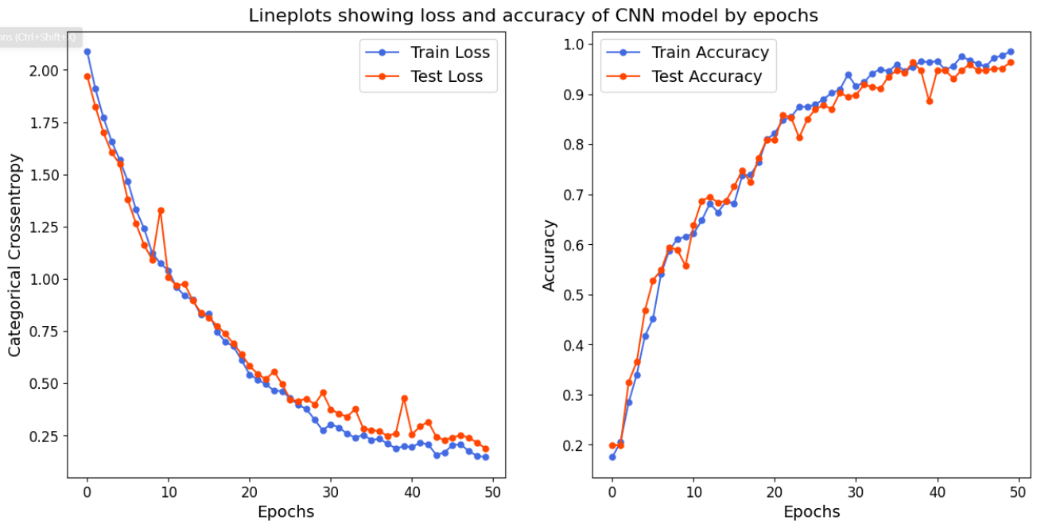
Evaluation of HOG-CNN

Slide 26
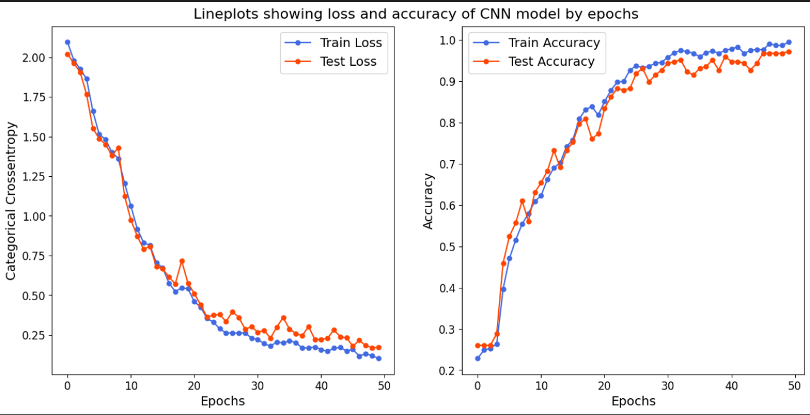
Evaluation of SIFT-CNN

Slide 27
Experimental Results of HOG-CNN and SIFT-CNN
 | Training Accuracy | Testing Accuracy
HOG | 98.58% | 96.34%
SIFT | 99.70% | 97.15%

Slide 28
Conclusion
This proposes a novel and effective framework for successful emotion recognition with the help of feature extraction and CNN. This study highlights that explicit key-feature extraction on the dataset can aid for an effective and efficient facial emotion analysis. Handcrafted feature extraction plays an important when you have a limited data collection and want to build the model without losing any significant or relevant information. The significant contribution/findings of the research carried out are: data feature extraction serves as a helpful procedure for accuracy improvement, reduces the risk of overfitting, speeds up the training process, improves data visualization and processing of data. Features are extracted using HOG and SIFT technique in this following research which are further used to train neural network and the architecture i.e. explicit feature extraction coupled with convolution net and additional deep neural layers have been the reason for this outperforming accuracy.

Slide 29

Resources Used
Research Paper
https://www.sciencedirect.com/science/article/pii/S1877050923001084
Dataset
https://r.search.yahoo.com/_ylt=AwrPoWK8BC1mozQoyqS7HAx.;_ylu=Y29sbwNzZzMEcG9zAzEEdnRpZAMEc2VjA3Ny/RV=2/RE=1714255164/RO=10/RU=https%3a%2f%2fwww.kaggle.com%2fdatasets%2fshawon10%2fckplus/RK=2/RS=xZj7MAOzCriFojsuePLmFTDHKMA-
SIFT
https://medium.com/@deepanshut041/introduction-to-sift-scale-invariant-feature-transform-65d7f3a72d40
HOG
https://towardsdatascience.com/hog-histogram-of-oriented-gradients-67ecd887675f

Slide 30
Thanks

